Slide 1


Legal Mate AI:
A Domain-Specific Indian Legal AI Model
for Legal Guidance and Complaint Assistance
PROJECT MEMBERS: PROJECT GUIDE:
P Praveen Kumar (24619125) Dr.G.Sangeetha
R Varshan (24619133) ( Assistant Professor )
P Naveen Kumar (24619124) ( Dept of AI&ML , VISTAS)
Department of Artificial Intelligence & Machine Learning (AIML)

Slide 2
Abstract
Legal Mate AI is an AI-based legal assistance and companion system designed to provide accessible, source-grounded preliminary legal information based on Indian laws. Many citizens face difficulties understanding legal terminology, identifying applicable laws, knowing their rights, and following complaint procedures. The proposed system combines Artificial Intelligence, Natural Language Processing (NLP), and Retrieval-Augmented Generation (RAG) to understand users’ legal queries, identify the relevant legal domain, and retrieve appropriate information from a curated Indian legal knowledge base. The project also focuses on developing a domain-specific Indian Legal AI model trained using curated legal problem descriptions, categories, intents, and question-answer examples. The system can explain legal rights, identify potentially relevant Acts and sections, analyze uploaded legal documents, generate structured complaint drafts, provide evidence and document checklists, and guide users through possible next steps. English and Tamil support is proposed. The system provides legal information and procedural guidance, not professional legal representation.

Slide 3
PROBLEM STATEMENT
• Legal information is often difficult for ordinary users to understand.
• Users may not know which legal category their problem belongs to.
• Finding relevant Acts, sections and procedures manually can be time-consuming.
• General search may return large amounts of unrelated information.
• Users need structured information based on their specific legal issue.

Slide 4
Objectives
Provide accessible, source-grounded preliminary legal information based on Indian laws.
Understand legal queries and identify the relevant legal domain.
Retrieve appropriate information from a curated Indian legal knowledge base.
Explain legal rights and identify potentially relevant Acts and sections.
Analyze uploaded legal documents and generate structured complaint drafts.
Provide evidence/document checklists and guide users through possible next steps.
Propose English and Tamil support.

Slide 5
Literature survey
YEAR | AUTHORS | PAPER/MATHOD | RELEVENCE TO THIS PROJECTS
2023 | Davide Taibi, Jorge Yero | Legal NLP: A Comprehensive Systematic Mapping Study | Establishes NLP and Transformer-based processing for complex legal documents.
2024 | Qiang Liu, Bo Chen | Named Entity Recognition Methods in Legal Instruments – Few-Shot Learning | Supports extraction of important legal entities using limited labelled data.
2025 | Al- Shareef | CHRXpert :An AI-Driven court of Human Rights Expert Assitant | Demonstrates AI-assisted analysis of complex legal cases and information
2026 | Milaf Abdullah, Sara Salman | SmartLaw Advisor: AI-Powered Legal Consultation and Contract Analysis | Demonstrates LLM, RAG and OCR-based legal consultation and contract analysis

Slide 6
Research Gap
Existing AI tools are not specifically designed for Indian legal queries.
Similar questions can involve different legal problems and user needs.
Generic AI responses may not always give relevant, situation-specific information.
Users need legal information that is supported by reliable sources.
There is a need to understand the user's legal intent before retrieving information.
Existing approaches can be improved by combining query classification and reliable information retrieval.

Slide 7
Existing System
Most existing AI legal tools provide general-purpose legal assistance rather than focusing specifically on Indian legal needs.
Users usually enter their questions as free text, but the system may not always identify the exact legal intent or type of problem.
General AI systems can generate answers without consistently connecting them to relevant and reliable legal sources.
Legal information may be spread across different sources, making it difficult for users to find the right information for their specific situation.
Existing solutions often provide information or answers, but do not provide a single workflow for understanding the issue, retrieving relevant information, and guiding the user.
Key Limitations
Limited focus on Indian legal context
Weak understanding of fine-grained legal intent
Generic or less situation-specific responses
Limited source-grounded legal information
No unified legal guidance workflow

Slide 8
Proposed System
Legal Mate AI accepts a user's legal problem in natural language and identifies the most relevant legal intent.
A 160-intent classification model organizes the query into one of 16 Indian legal categories.
The predicted intent is passed to a Retrieval-Augmented Generation (RAG) module to retrieve relevant Indian legal information from a curated knowledge base.
The system combines intent classification and source-based retrieval to provide structured legal information, relevant sources, and possible next steps.
Key Benefits :
Fine-grained legal issue identification Fine-grained legal issue identify
Relevant information retrieval
Source-grounded legal guidance
Structured and user-friendly responses

Slide 9
SYSTEM ARCHITECTURE
NLP UNDERTSNDING
LLEGAL INTENT CLASSIFICATION
STRUCTURED LEGAL GUIDANCE
USER QUERY / DOCUMENTSSER
RAG RETERIVAL
Preprocess and understanding the query / documents
Use predicted legal intent
Legal Information /
Rights
Relevant Acts and Sections
Documents Analysis
Complaint Draft
Evidence / Document Checklist
Possible Next Step
LEGAL QUESTIONS
eg.” What are my rights in a property”
Classify the user’s query one of 160 predefined legal intents and identify and relevant legal domain
Extract the relevant information
Search curated Indian legal knowledge base
t Retrieve relevant Acts, Sections & Procedures
UPLOAD LEGAL DOCUMETS
eg. FIR , Notice , Agreements, Court order, etc.
Identify the important entities and keywords
Baseline model
TF - IDF + Linear SVC
Main Transformer Model
DistilBERT
Retrieval-Augmented Generation (RAG)
Prepare input for legal intent classification
OUTPUT
Predicted legal Intent
Legal domain
source-grounded legal context
LANGUAGE SUPPORT
CURATED INDIAN LEGAL KNOWLEDGE BASE

Slide 10
Methodology
User input: legal question or uploaded legal document.
NLP-based understanding of the query and identification of the relevant legal domain.
RAG retrieves appropriate information from the curated Indian legal knowledge base.
The domain-specific legal AI model uses curated problem descriptions, categories, intents, and question–answer examples.
The system produces structured guidance such as rights, relevant Acts/sections, document analysis, complaint drafts, checklists, and next-step guidance.

Slide 11
Technologies Adopted
AI / ML
* Python
* PyTorch
* Hugging Face Transformers
* DistilBERT
* Scikit-learn
d
  DATA
  * Pandas
  * CSV Datasheet
  * Train / Validation / Test
RAG
* Embedding Model
* Vector Database
* ChromaDB
* Retrieval Pipeline
APPLICATION
* Fast API
* Flutter
* Android
DEVELOPMENT
* VSCode
* Python Virtual Environment
* NVIDIA GPU / CUDA

Slide 12
Dataset
Classification Dataset
16 Le
16 Legal Categories Categor
160 Legal Intents
8,000 Query Examples
50 examples per intent
6,400 Training
800 Validation
800 Test
Scenario-based split to avoid overlap between datasets
RAG Knowledge Base
Indian Acts & Sections
Legal Procedures &Guidelines
Case Summaries & Judgments
Legal Categories & Examples
Curated Legal Q&A
Documents are processed, chunked and indexed for relevant retrieval
Scenario-based Dataset
No Duplicate Queries Across Splits
Source based RAG Knowledge

Slide 13
Implementation
Dataset & Preprocessing
Prepare 160 legal intents
Validate 8000 query examples
Create train / validation / test splits
Perform duplicate and leakage checks
2. Classification Models
TF – IDF + LinearSVC baseline
DistilBERT transformer model
Train using the training dataset
Select model using validation performance
3. Evaluation & Error Analysis
Accuracy , Precison and Recall
Macro F1 score
Confusion Matrix
Analyse incorrect validation predictions
4. RAG & Application Integration
Process Indian legal score documents
Chuck and index legal information
Retrieve relevant legal content
Connect classifier , RAG and application
Data Preprocessing Classification Evaluation RAG Retrieval Application

Slide 14
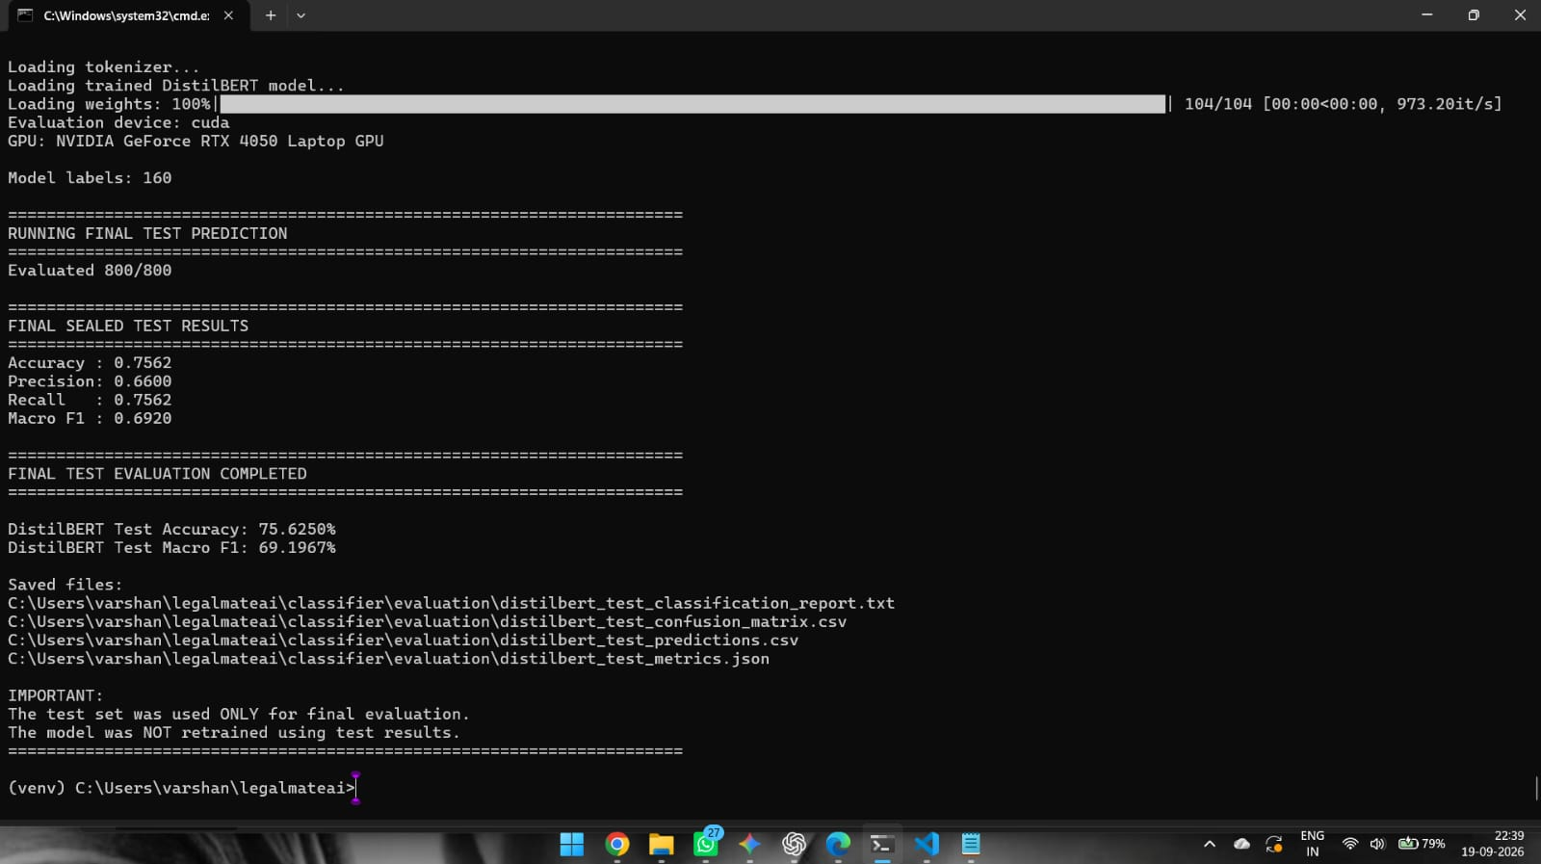
Results
Classification Model Results
Baseline TF-IDF + LinearSVC achieved 67.50% test accuracy.
DistilBERT achieved 75.63% test accuracy.
Macro F1 improved from 61.11% to 69.20%.
DistilBERT improved test accuracy by 8.13 percentage points.
Final evaluation was performed on 800 sealed test examples.

Slide 15
Future Enhancements
1.Model Optimization
Improve the classification Performance
Refining Confusing Legal Intents
Improve the training data quality
2. Advanced Legal RAG
Expand the Indian Legal Knowledge base
Add more acts , sections and Judgements
Improve the retrieval Relevance
3. Multilingual Support
Tamil Language Support
Support More India languages
Improve the accessibility for the user
4. Legal Document Analysis
Upload FIR’s , Notices and agreements
Extract relevant information
Provide structured documents insights
5. Complaint / Application Drafting
6. Complete Flutter + FastAPI Android App

Slide 16
Conclusion
Legal Mate AI provides a structured approach for assisting users with Indian legal information.
A 16-category, 160-intent classification system has been designed.
An 8,000-example legal query dataset has been prepared with separate training, validation and test sets.
TF-IDF + LinearSVC was developed as the baseline and DistilBERT as the main classification model.
A RAG-based legal knowledge base is being developed to provide relevant, source-based legal information.
The system is being extended toward FastAPI backend and Flutter application integration.

Slide 17
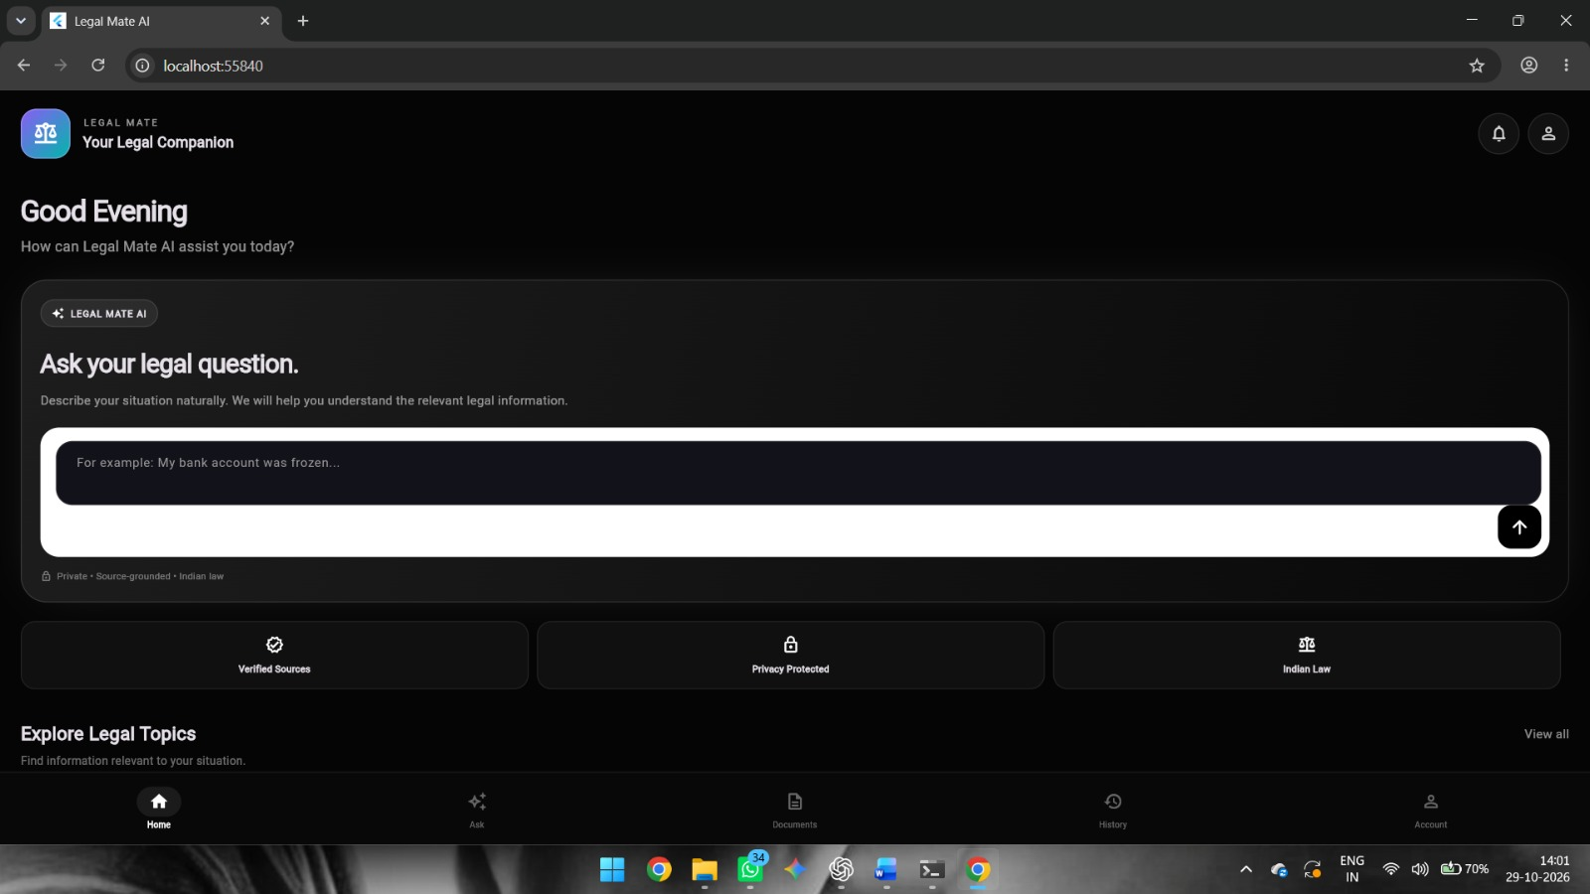
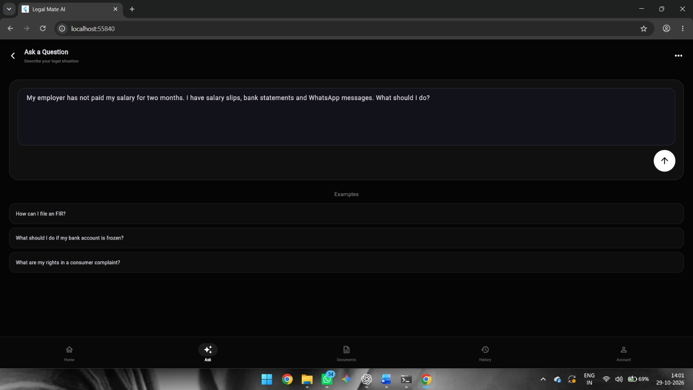
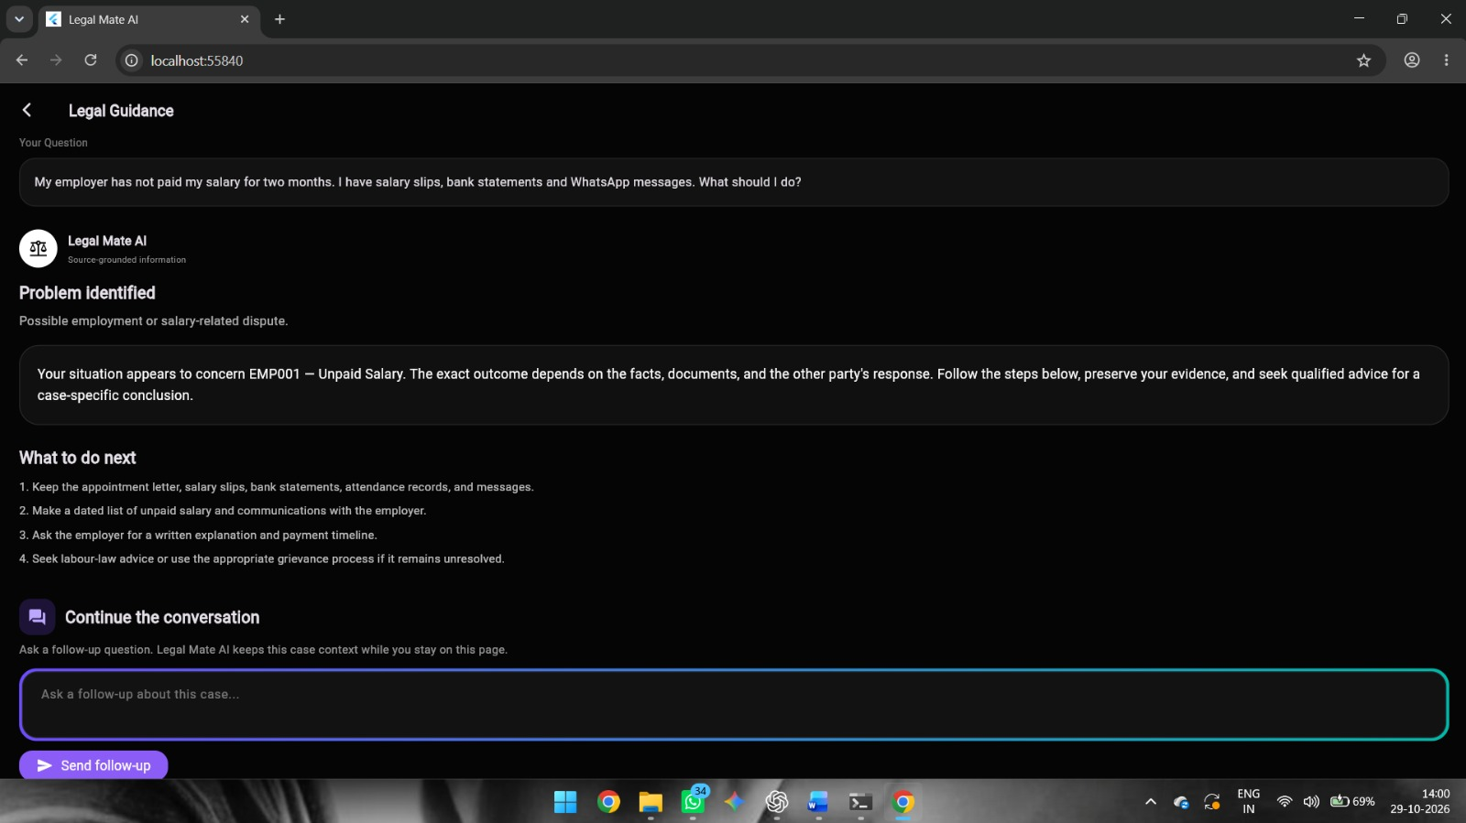
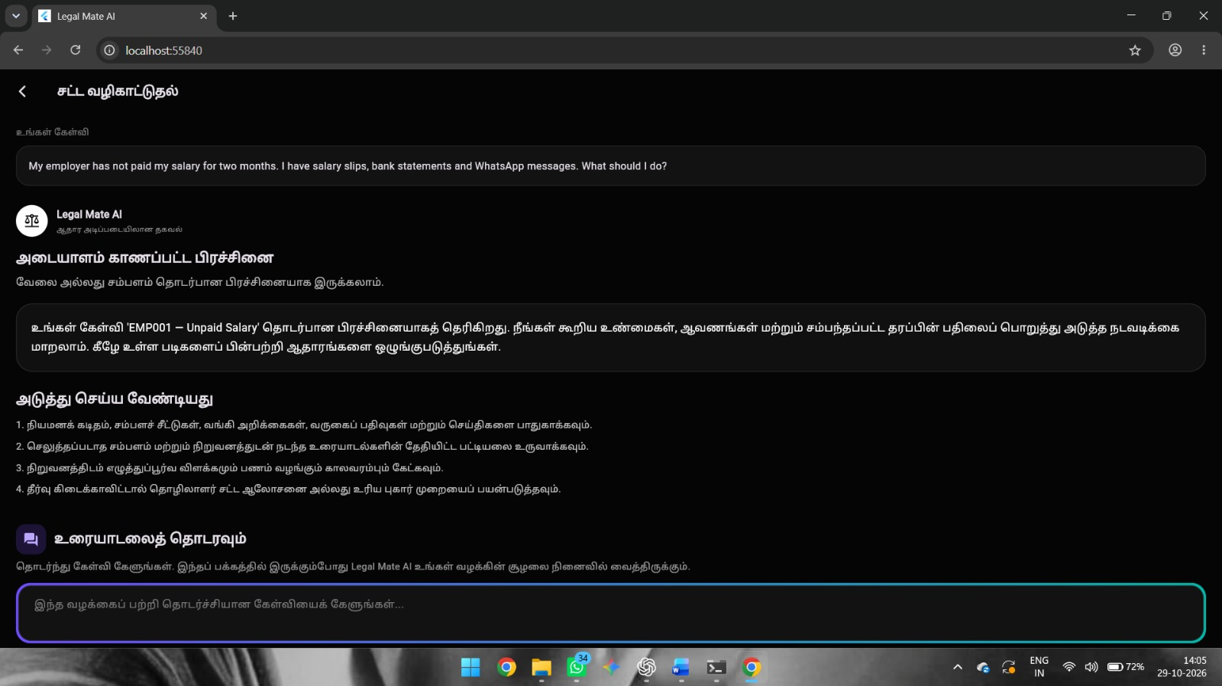
Output

Slide 18
THANK YOU

